Slide 1
HOUSE RENTAL SYSTEM
Team 18
Anusha Chandrakanth
Charmi Dalal
Dinesh Kumar Ravikumar

Slide 2




About Our System
Rent Property
The House Rental System provides a robust multiparty digital platform for buyers and sellers to buy/rent property along with Service Providers such as cleaners,electricians,plumbers,packers and movers. Additionally, our application also provides an option for prospective buyers to get loan approval from the Government Agency online to buy the property seamlessly.
.
Hire Agent
Hire Service Providers
Hire Inspector
Hire Property Manager

Slide 3


This has accelerated the housing market to start operating digitally which has eventually caused a new breakthrough in Housing system. Many buyers are not able to find the right affordable houses in locations of their choice and there is a challenge in the communication system of the multiparty involved and also to get the financial support from the government agency.
Problem Statement
House sales are hit hard by the current pandemic.The house rents have risen and many are unable to find an affordable apartment. House rents are rising 2.3% every month, yet the unemployment rate has risen to 6.8% since the outbreak of the pandemic.

Slide 4
Issues Addressed
Our application provides an extensive virtual-digital experience to the prospective buyers through good communication system and user-friendly features such as SMS ,Email notification, Photos and Map location of the property, to find affordable apartments with service providers including real estate agents, packers, movers, and cleaning services.
Additionally, it also provides an option for buyers to get financial aid / loan approvals from the Government Agency without much hazzle.

Slide 5
Extra Features
SMS Notification to buyers and service providers
Email Notification to buyers and service providers
Location of the property on the Map

Slide 6
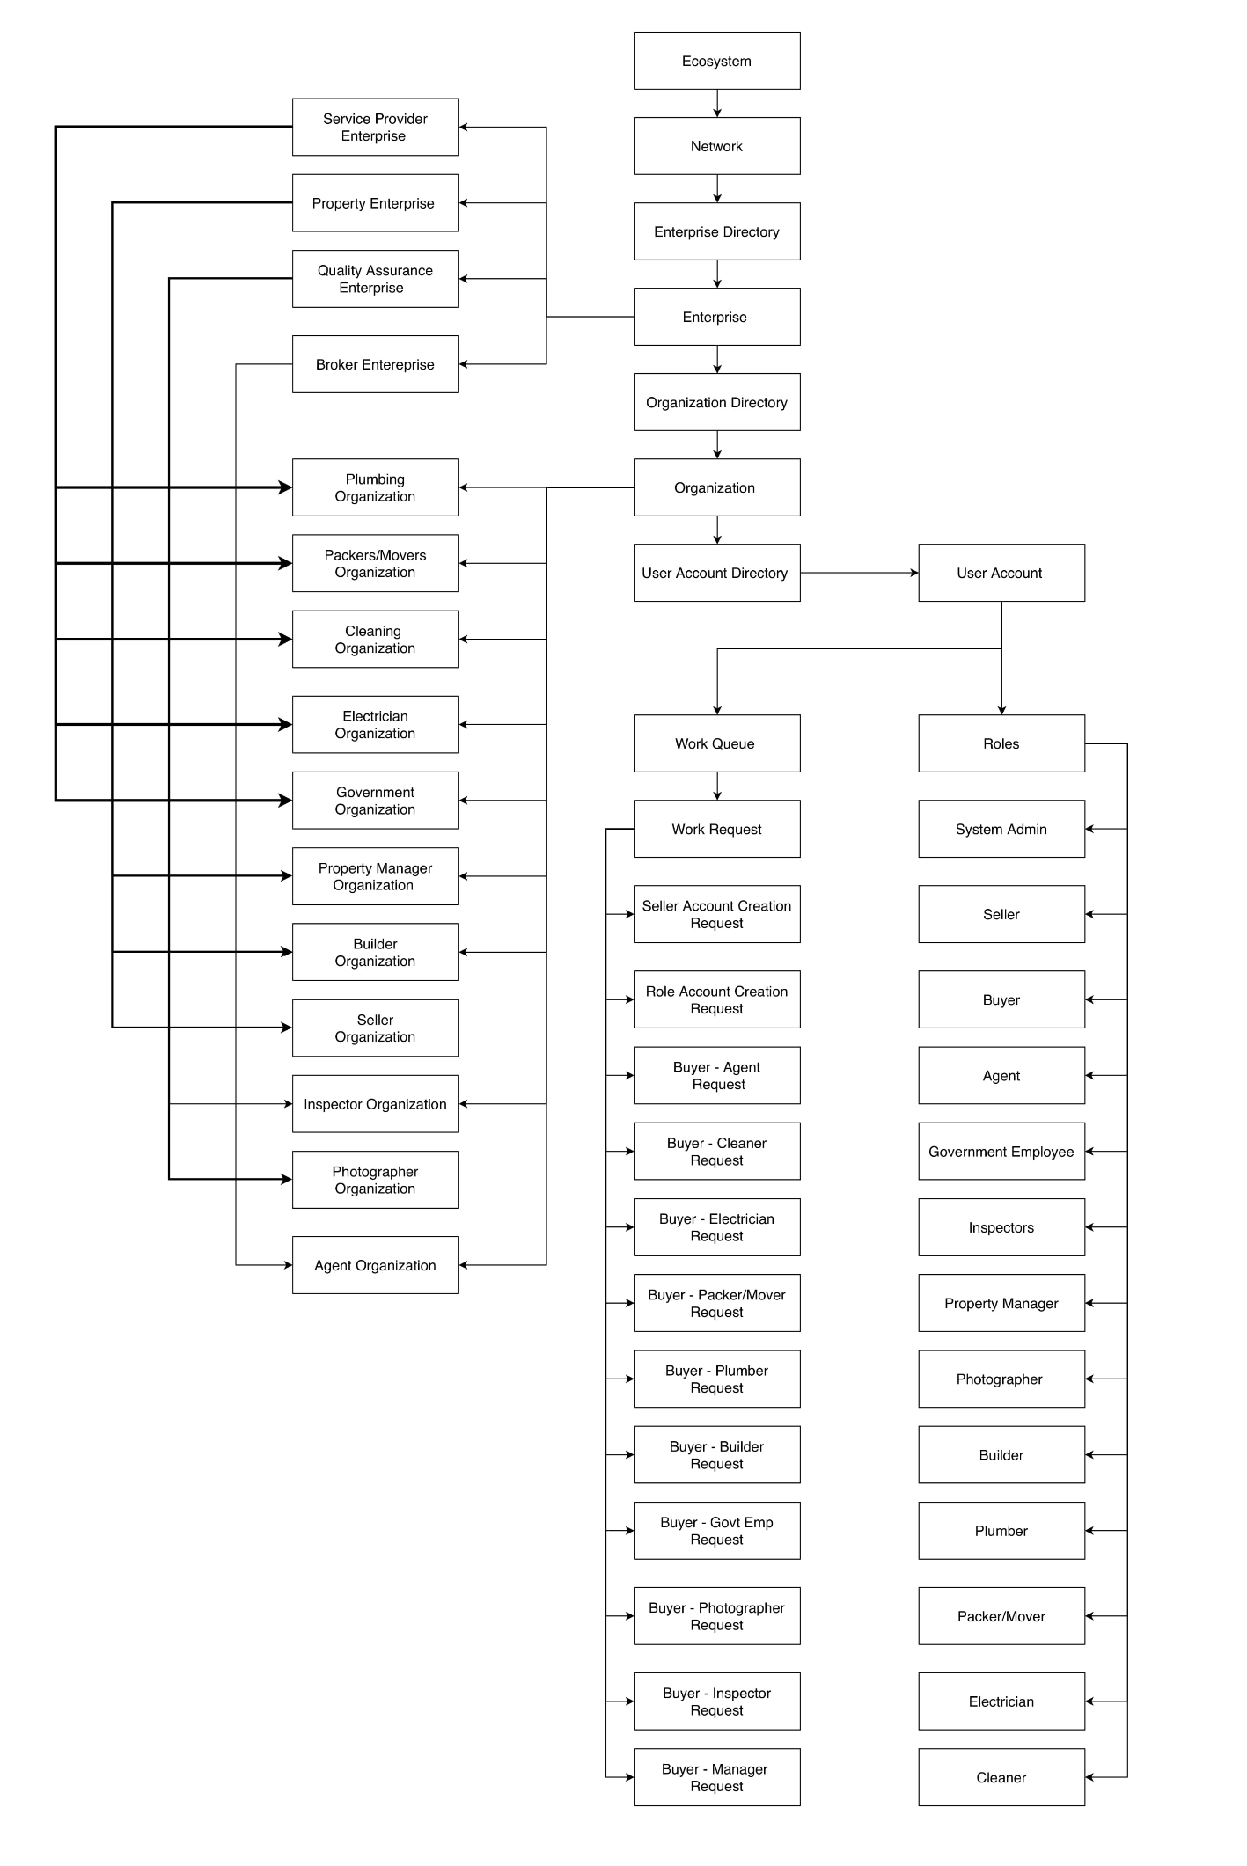
Ecosystem Architecture Diagram

Slide 7
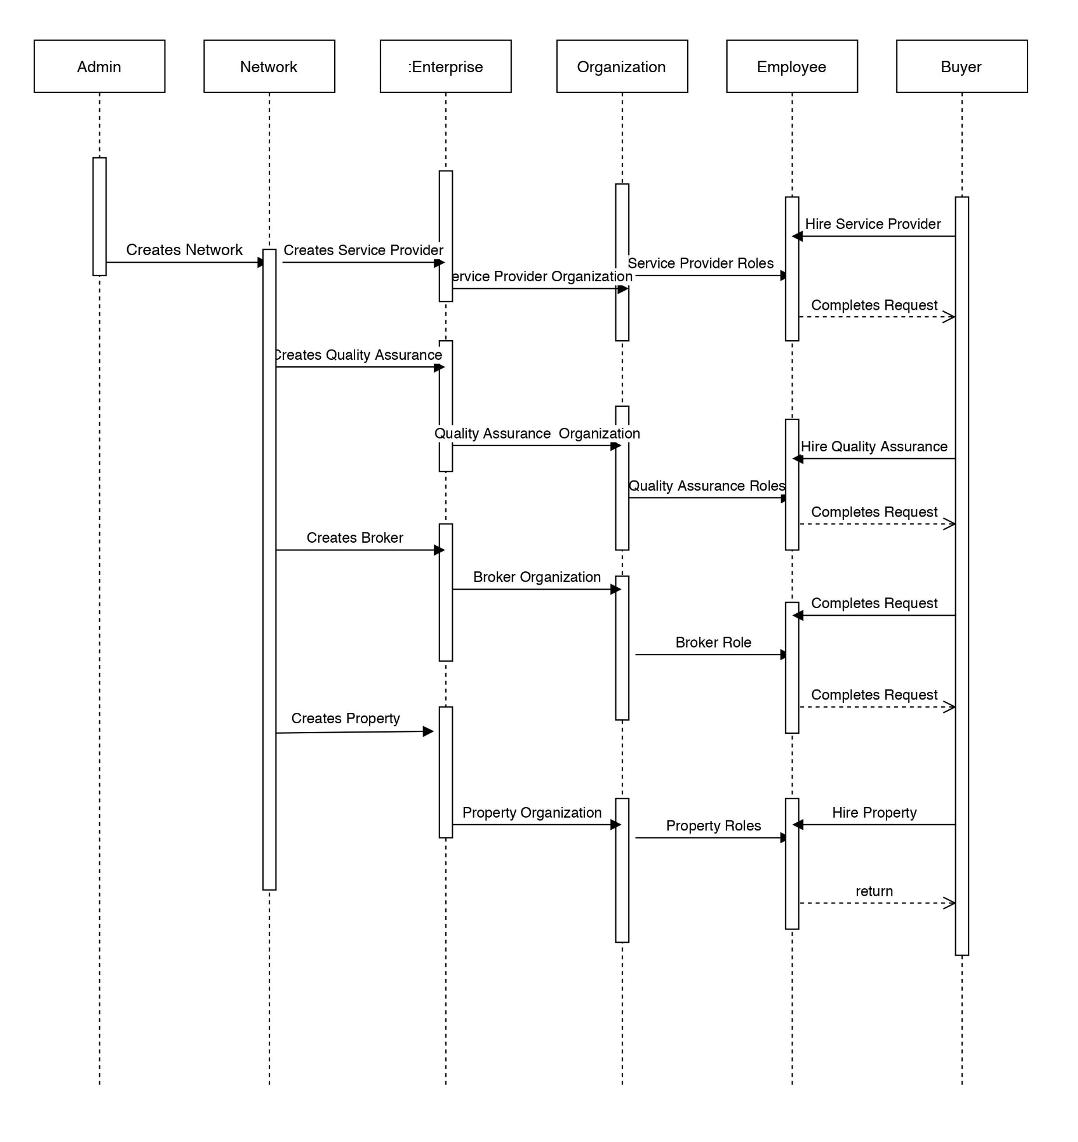
Design : Sequence Diagram

Slide 8
Roles and Responsibilities
System Admin Role
The responsibility of this role is to create enterprises, networks and enterprise accounts.
Property Admin
The responsibility of this role is to create property organizations, employees and user accounts and validate the org registration requests.
Broker Admin
The responsibility of this role is to create broker organizations, employees and user accounts and validate the org registration requests.
Service Providers Admin
The responsibility of this role is to create service provider organizations, employees and user accounts and validate the org registration requests.

Slide 9
Roles and Responsibilities
Quality Assurance Admin
The responsibility of this role is to create QA organizations, employees and user accounts and validate the org registration requests.
Buyer
The prospective buyer browses the list of vacant houses to buy .
hire an Agent to get the list of suggested house
hire various service providers – cleaner,plumber,electrician,packers and movers.
hire Builder and Property Manager to get the details of the house.
Seller
The seller can create advertisement for his property with all the house details along with the photo to showcase the house is on sell.

Slide 10
Roles and Responsibilities
Agent
The agent is responsible for suggesting list of houses vacant for the buyer.
PropertyManager
The property manager is capable of hiring various service providers for the property.
Government Agency
The government agency provides loans and discounts to buyers to support them financially to buy the property.
Inspector
The inspector inspects the house for the prospective buyers of their choice and provides feedback on the state of the house.

Slide 11
Roles and Responsibilities
Builder
The builder is capable of providing the details of the house to the buyer with feedback communication.
Service Providers
There are various service providers for the property such as
Cleaner
Plumber
Electrician
Packers and Movers
Photographer

Slide 12
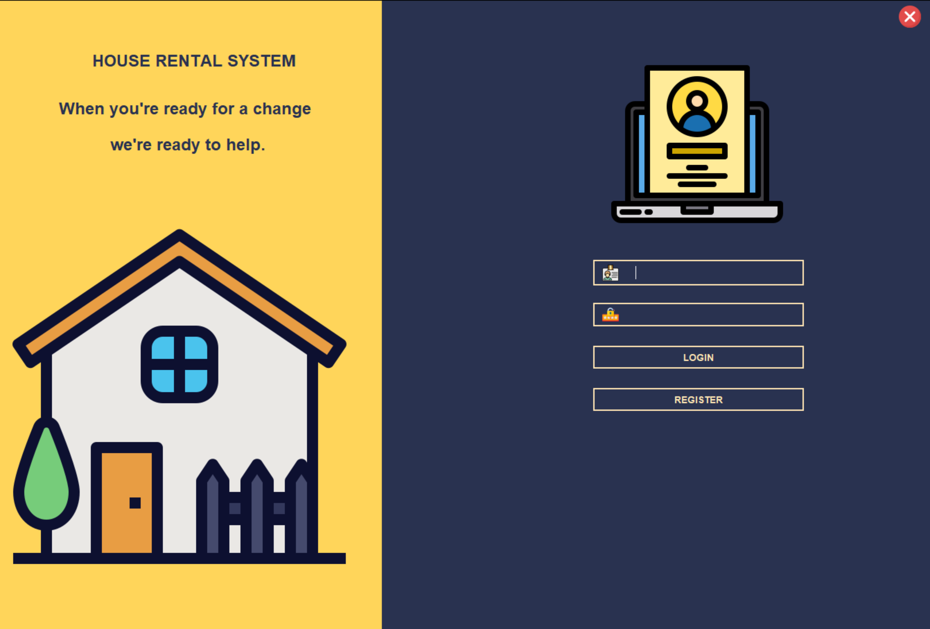
Home Page

Slide 13
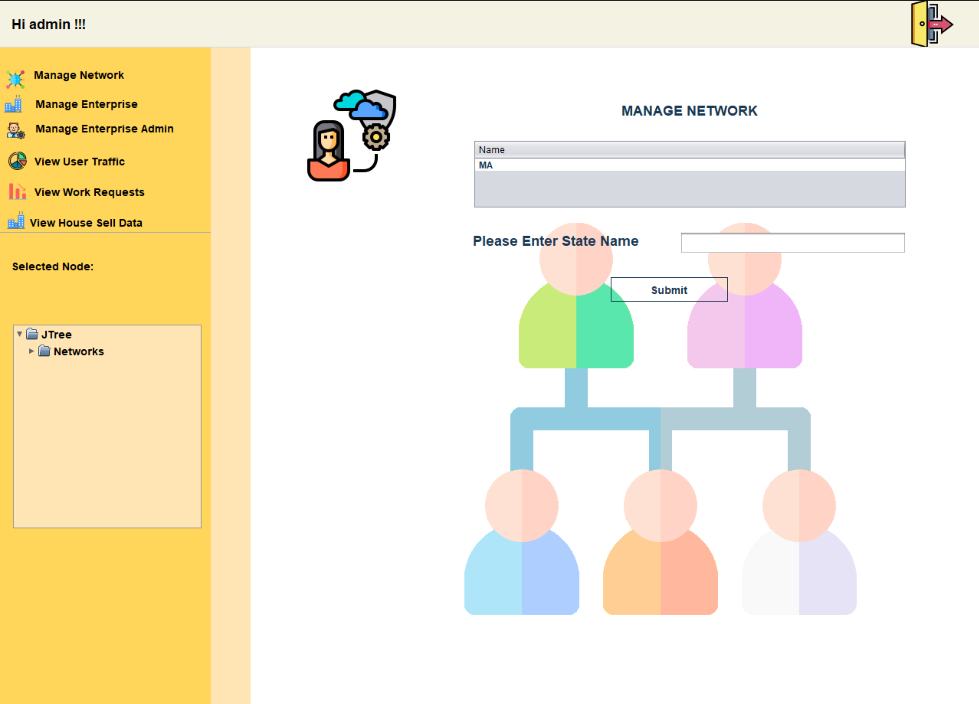
System Admin

Slide 14
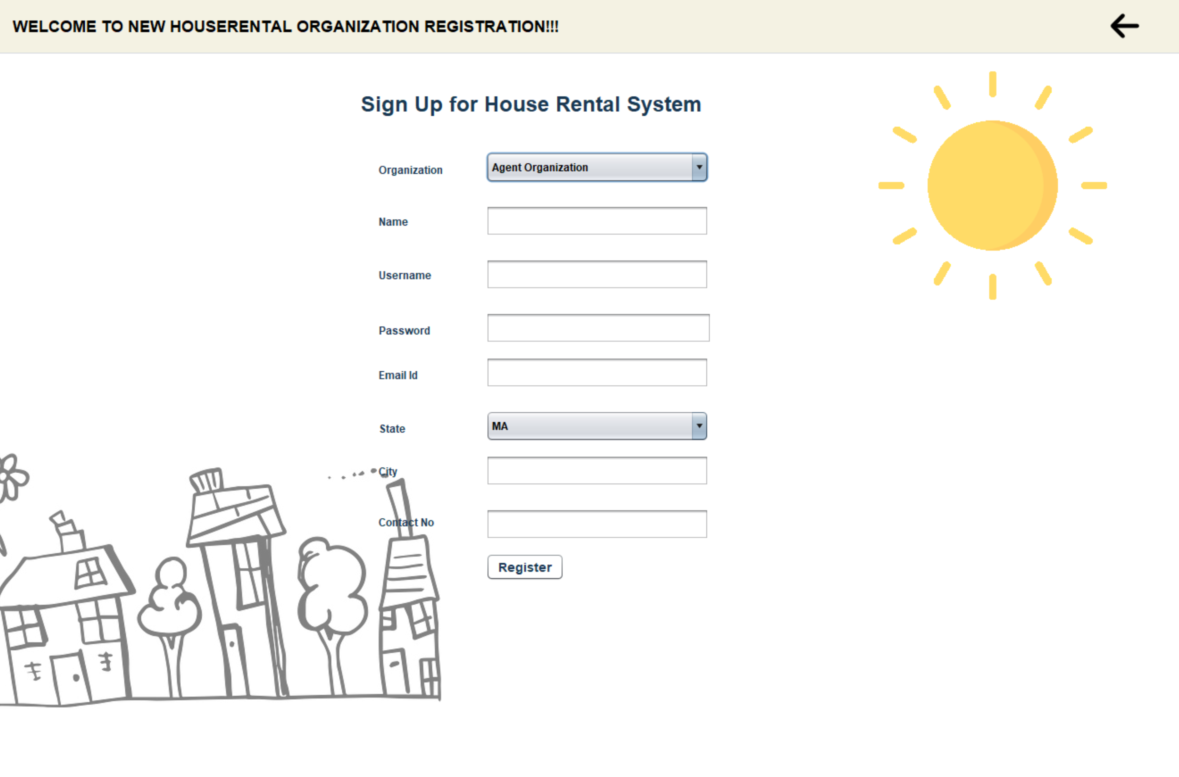
User Registration Page

Slide 15
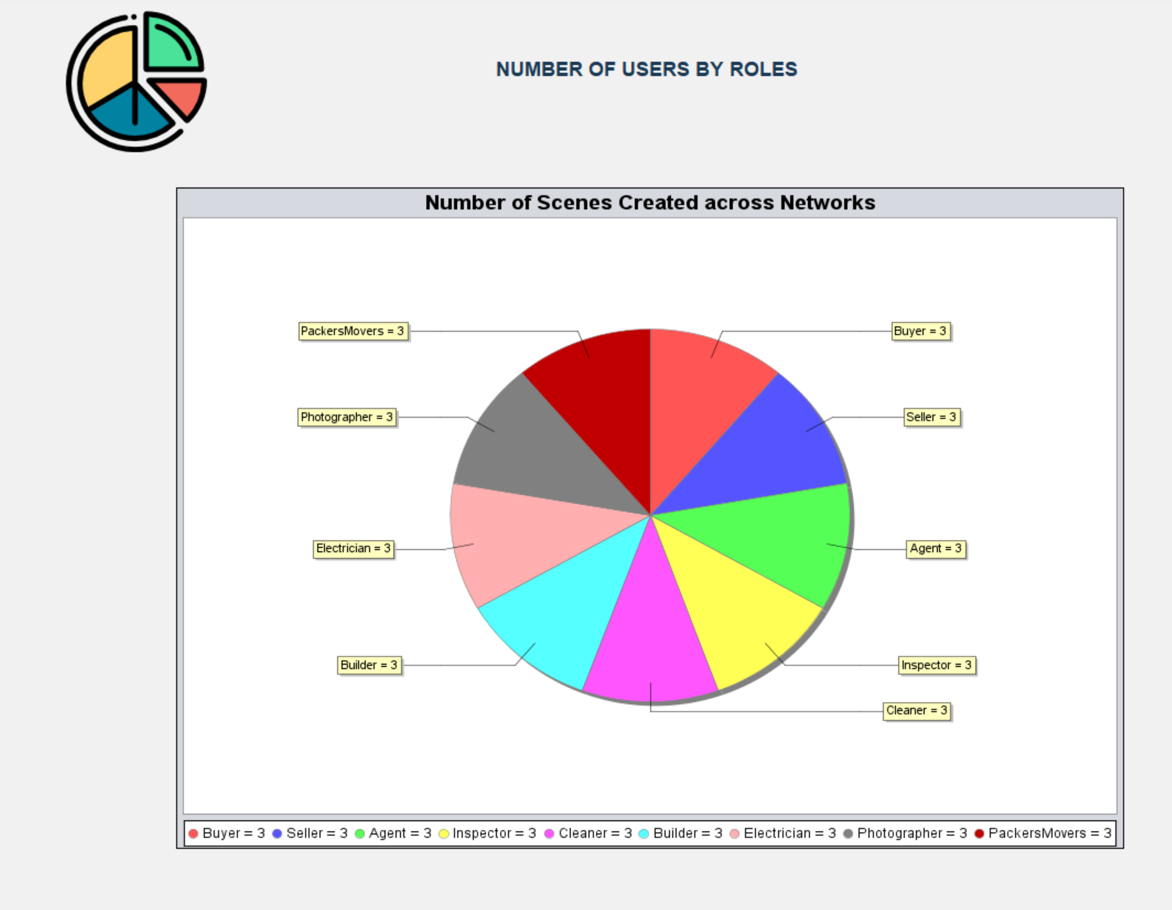
Graph : Number of Scenes created across Networks

Slide 16
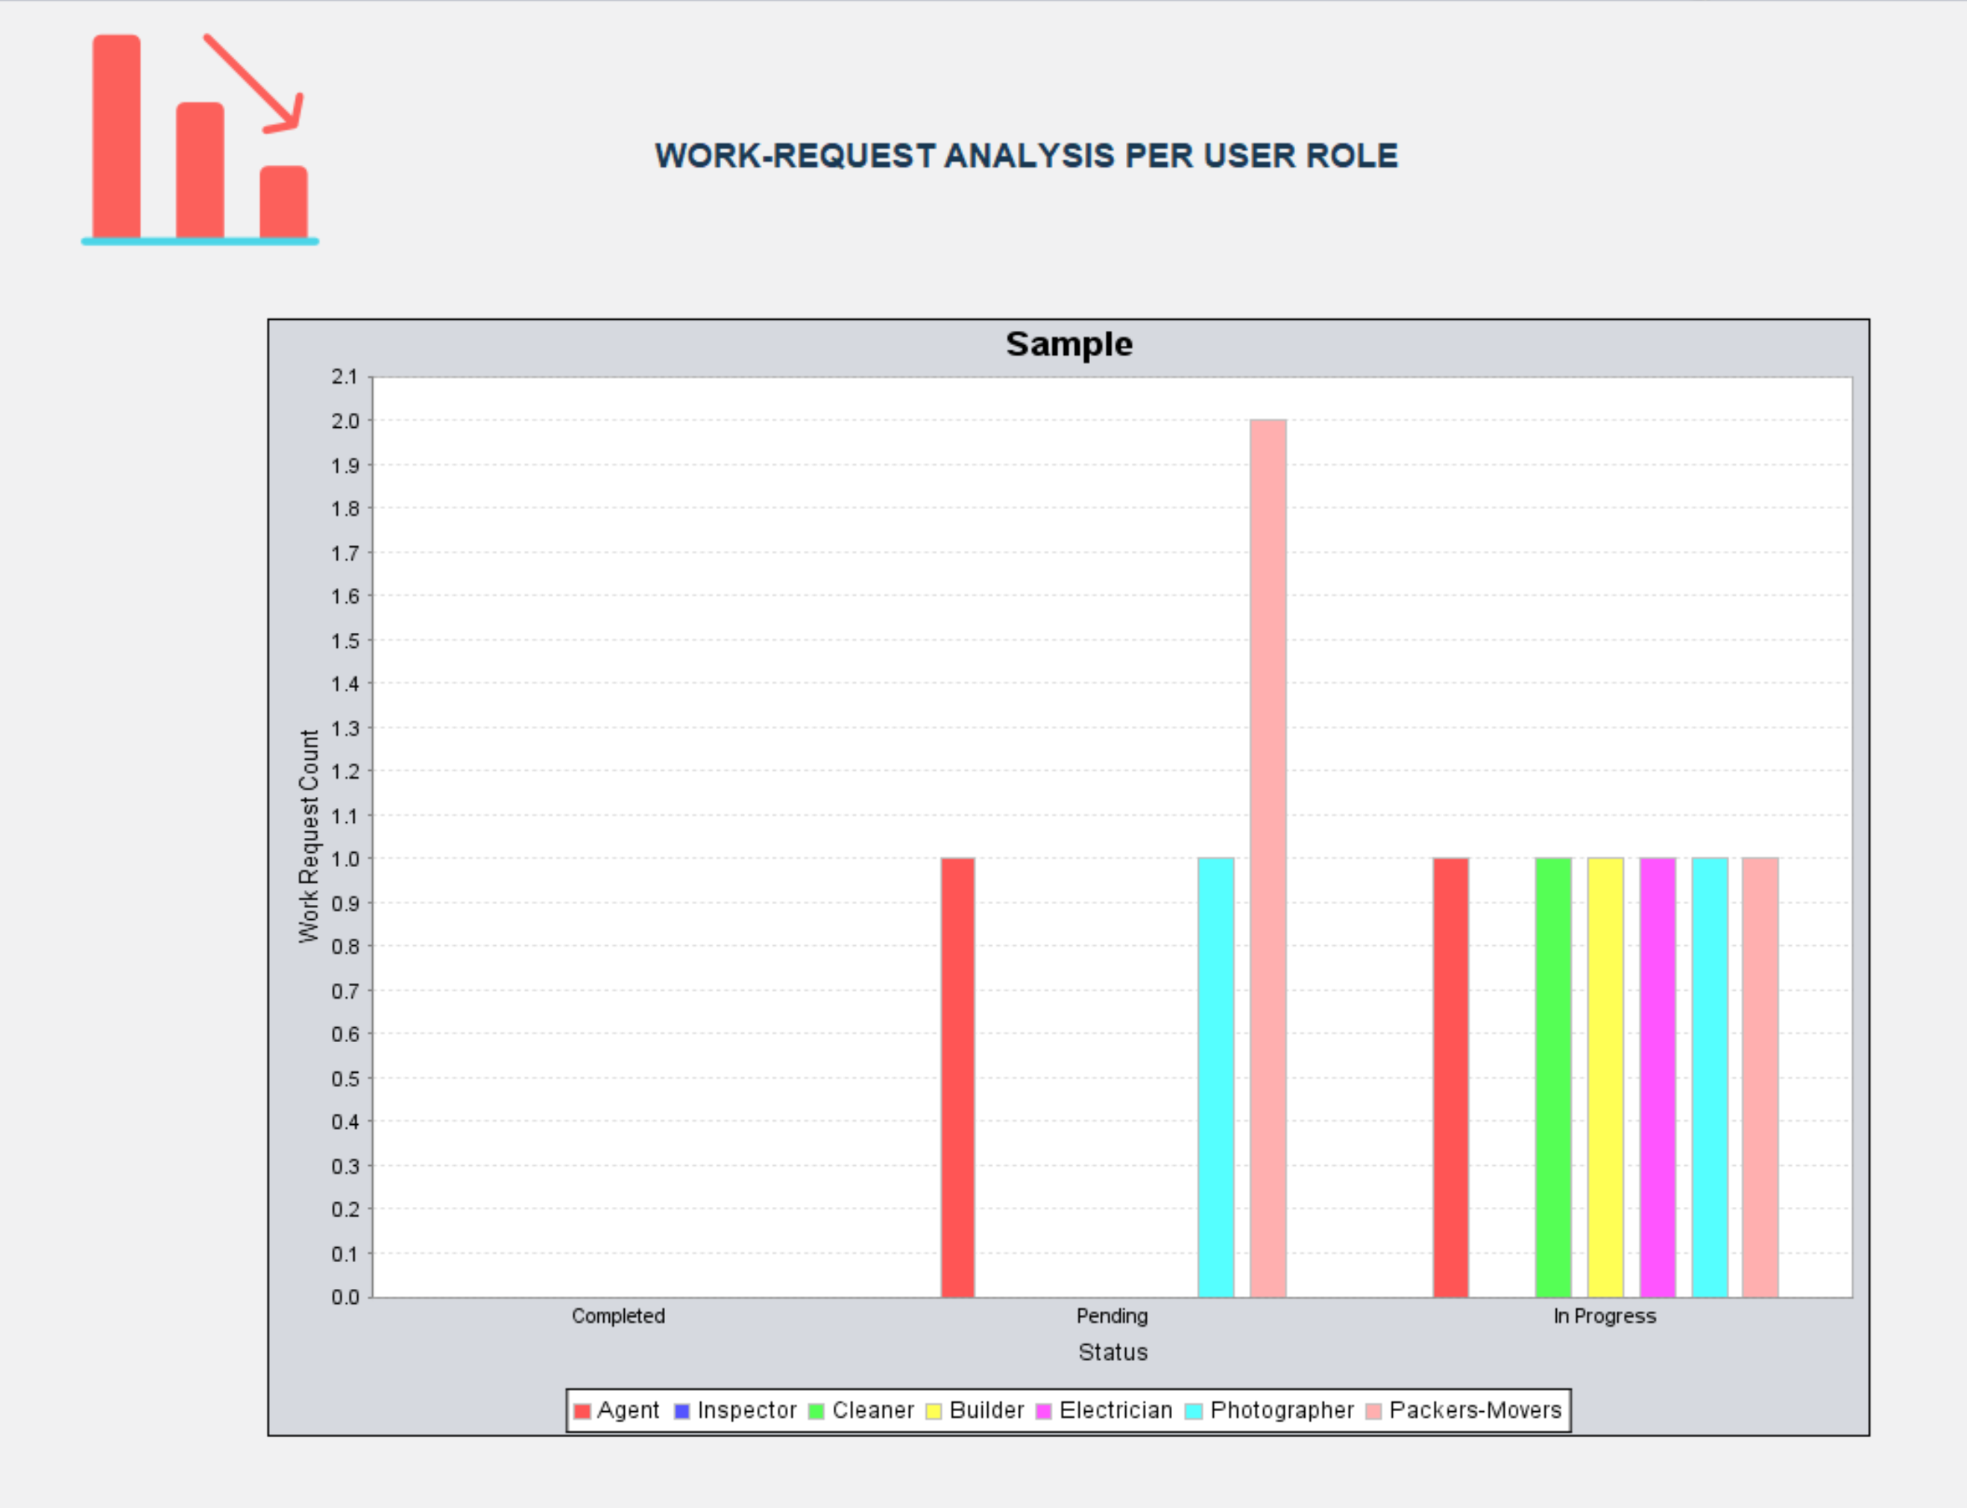
Graph : Work Requests analysis per user role

Slide 17
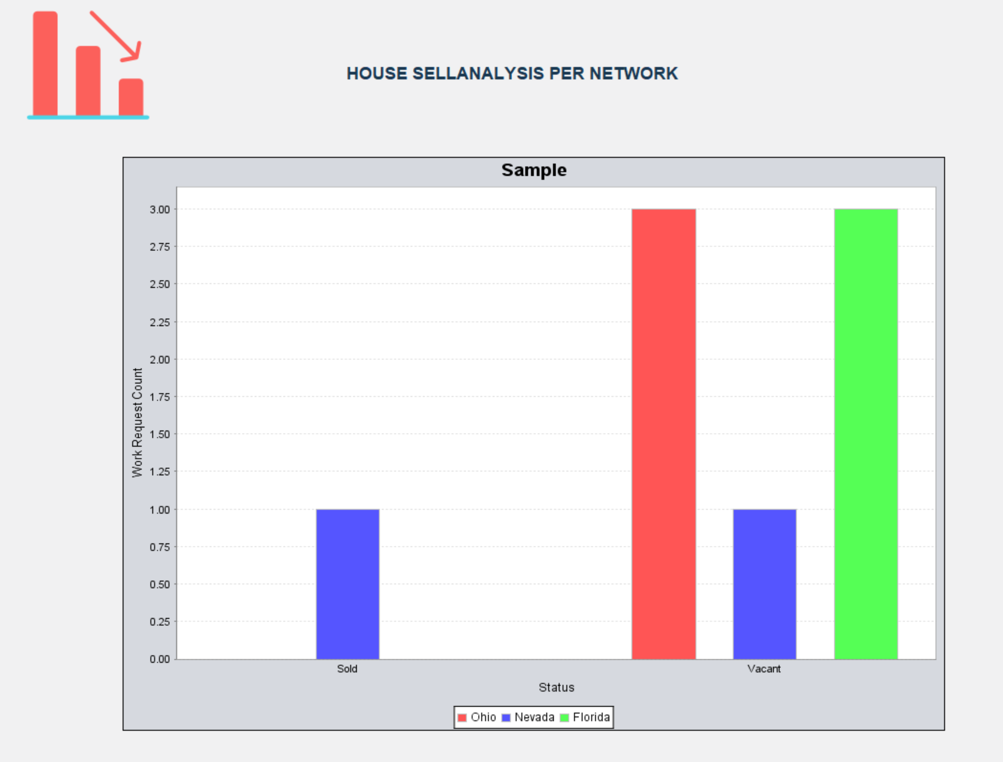
Graph : House Sale Analysis per Network

Slide 18
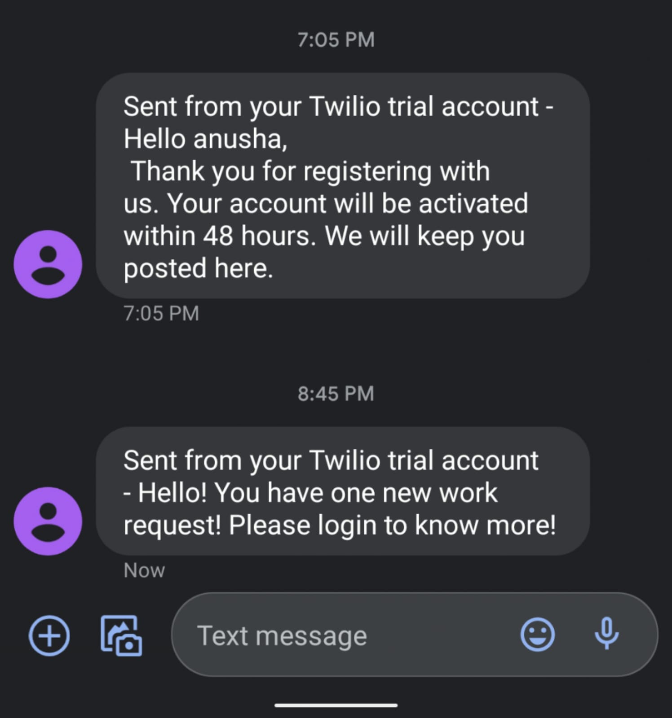
SMS Notification

Slide 19
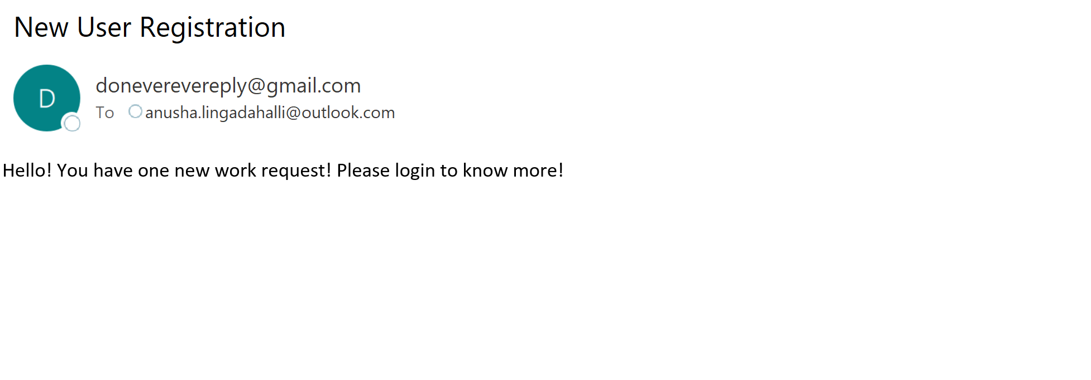
Email Notification

Slide 20
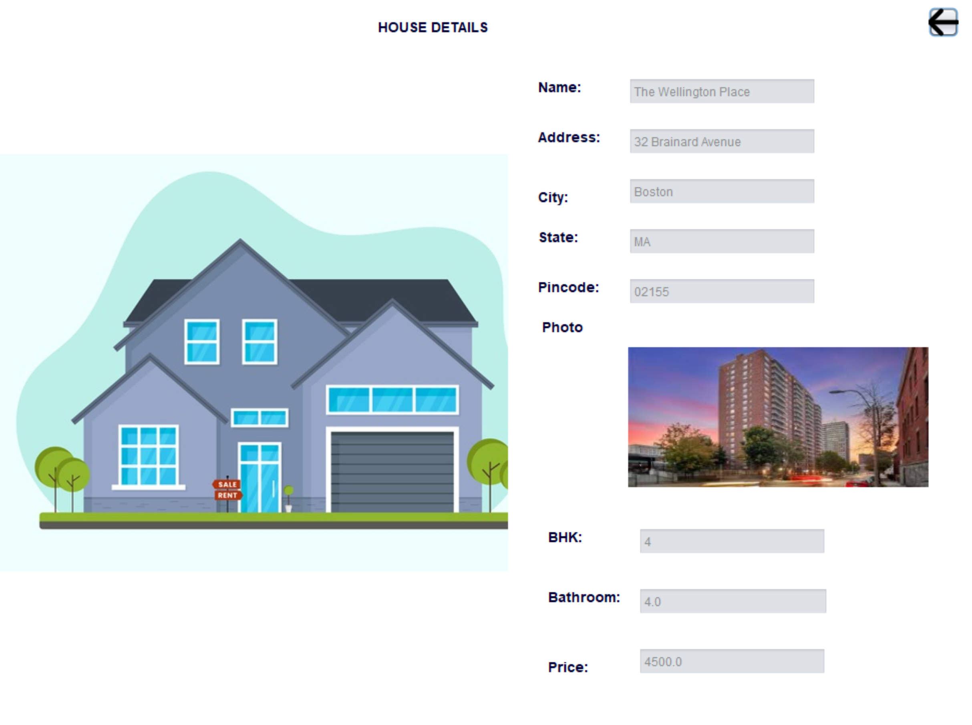
House Details with Photo

Slide 21
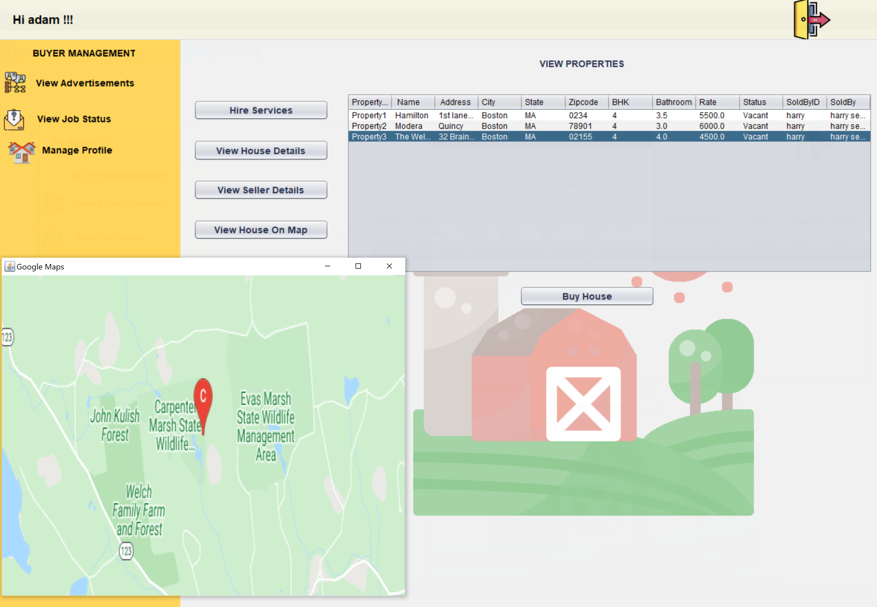
Location of the property on Map

Slide 22
DEMO

Slide 23
THANK YOU

